Slide 1

Performance Measures
Matthew Engelhard
Notes:
Hi everybody
In this lecture, we’ll be learning about measures commonly used to assess classification performance
Having an in-depth understanding of these measures is critical when evaluating a model, whether it’s one you’ve developed or one you’re reading about in a scientific article
Throughout the course, we’ll be thinking about what these measures mean, mathematically, as well as their practical significance in a clinical or healthcare scenario

Slide 2

Goals
Understand common performance measures for binary classification
Recognize that which measure(s) are most appropriate depends on the application
Run through a few different clinical scenarios
Touch on metrics for problems other than binary classification
Notes:
By the end of the lecture, you should understand the concepts of model discrimination and model calibration
And you should be able to define them
You should also be able to list common measures of discrimination performance and describe how they are calculated
Lastly, this will be an important first step toward building intuition around which performance measures are the best match for a given application
This will be introduced in the lecture, but you should also spend some time thinking through which performance measures you believe are best matched to the various clinical scenarios

Slide 3
Let’s go back to cancer prediction
(NEGATIVES)
(POSITIVES)
Notes:
We’ll begin by going back to cancer prediction
Rather than a PSA level, this time we have a model that predicts the probability of cancer based on information about the patient
Similar to before, we’re able to compare this prediction to a gold standard measurement of cancer status in our training dataset
In the top panel, we have predicted probabilities for individuals who did not have prostate cancer, and on the bottom, we have all the values for those who did
For more detail on the plots we’re using here, please take another look at lecture 1

Slide 4
below threshold: predict negative
above threshold: predict cancer positive
(NEGATIVES)
(POSITIVES)
Notes:
Last time we considered this problem, we said that our goal was to find a best rule for predicting whether cancer is present based on these values
Said another way, we’re interested in discriminating positive and negative cases, and we want to find a good threshold for doing so
This is what we ought to care about if we’re using our model to make a binary decision – maybe we’re going to treat one group and not the other, or we’d like to decide whether to schedule additional diagnostic testing
And to do this well, it doesn’t really matter whether our predicted probabilities are accurate
All that matters is whether the values tend to be higher for positive cases than for negative ones. As long as that’s true, the values allow us to discriminate between groups effectively
However, there are other cases in which we do care about the actual values that have been predicted rather than just their relative order
Let’s suppose we were going to order a biopsy based on this prediction, and we wanted to calibrate the patient’s expectations by telling them how likely it is that the biopsy will come back positive
In this case, if we tell them the risk is 45%, we’d like to be confident that given the information available so far, there really is about a 45% chance that the biopsy will come back positive
Said another way, in this case we care about is whether our predicted probability is a good estimate of true risk – this is called model calibration

Slide 5
Assess Calibration Graphically
Q1 Q2 Q3 Q4 Q5
(NEGATIVES)
(POSITIVES)
Notes:
There are a number of measures used to assess calibration
All of them involve looking at the difference between model-predicted probabilities and estimate of true risk
We’re going to focus less on calibration in this course, but we’ll consider a simple, graphical approach that is the basis for several commonly used calibration metrics
First, we’ll divide model-predicted risk into quintiles
This could also be deciles, for example, but we’ll stick to a small number of groups here to keep things simple
In each quintile, we can calculate what proportion of patients ended up with a positive biopsy.
In a calibrated model, this proportion should be similar to the average model-predicted risk in that quintile

Slide 6
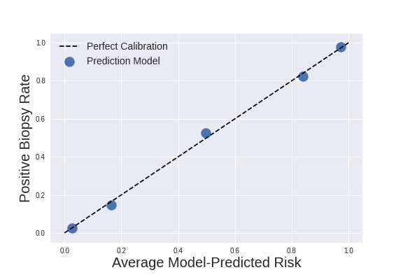
Assess Calibration Graphically
Notes:
If we do that for each quintile, we get a scatter plot that tells us how well model-predicted probabilities agrees with true event probabilities in each quintile
In a perfectly calibrated model, these values should match
This model is very close to perfect calibration
If we wanted to put a number on calibration, we might look at the slope and intercept of a best fit line connecting these points
Or we might use a test statistic based on these values
But in many cases, a graphical approach will suffice

Slide 7
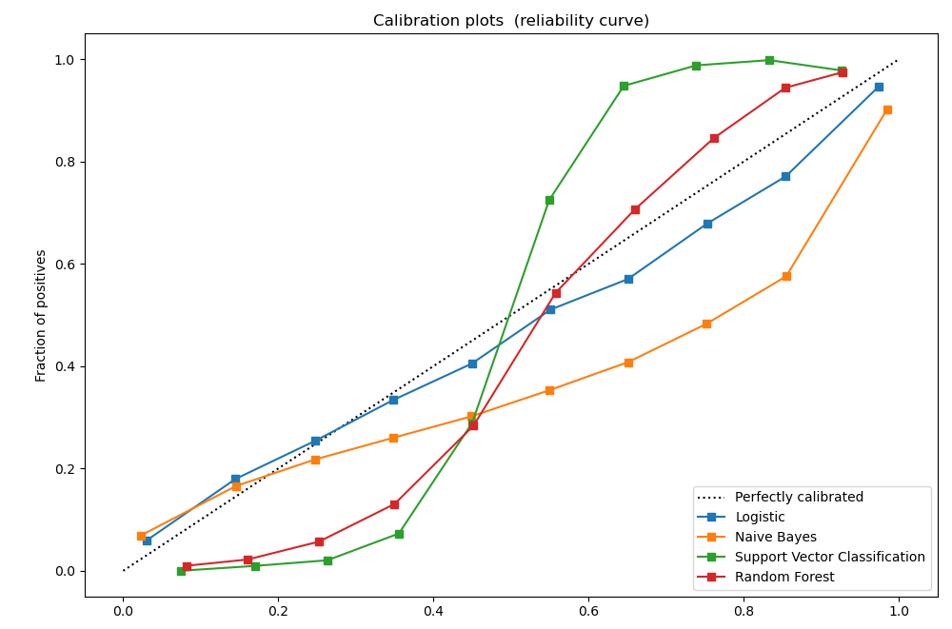
Assess Calibration Graphically
Model-Predicted Risk
From: https://scikit-learn.org/stable/modules/calibration.html
Notes:
Just to give you a sense of what a more typical calibration plot might look like, here’s an example from the scikit-learn documentation

Slide 8
below threshold: predict negative
above threshold: predict cancer positive
(NEGATIVES)
(POSITIVES)
Notes:
Having briefly covered calibration, let’s go back to discrimination performance, which is what we’ll be measuring most of the time in this class
Once we pick a threshold to place on the model predicted values, our cases can be divided into four groups.

Slide 9
below threshold: predict negative
above threshold: predict cancer positive
TRUE NEGATIVES
FALSE POSITIVES
(NEGATIVES)
FALSE NEGATIVES
TRUE POSITIVES
(POSITIVES)
Notes:
When the model-predicted risk is below the threshold, we predict that that patient is negative – in this example, we predict they don’t have cancer
If we’re right, and they’re truly negative, that’s a true negative
If we’re wrong – they do have cancer – that’s a false negative
When the model-predicted risk is above the threshold, we predict that the patient is positive
If we’re right and they’re truly positive, that’s a true positive
If we’re wrong – they don’t have cancer – that’s a false positive
Having set a threshold, we can also calculate four primary metrics
Metrics:
Sensitivity (aka recall, tpr), is the number of true positives divided by the number of positive cases, which is the true positives + false negatives
Specificity (1-fpr), is the number of true negatives divided by the number of negative cases, which is the true negatives + false positives
Positive predictive value (precision), is the number of cases above are threshold that are actually positive – in other words, the true positives divided by the true positives + false positives
And the Negative predictive value is the number of cases below the threshold that are actually negative
Back in the first lecture, we talked about which of these metrics depend on the prevalence. This is an important point, so if you aren’t sure, please go back to the first lecture and think through this point carefully.
But now we’re going to go a step further and describe how these values change as we move the threshold

Slide 10
ROC versus PR curve: two different tradeoffs
Notes:
Most commonly, we’ll be looking at the ROC curve, as shown in the plot on the left.
To create this curve, we slowly move our threshold from 0 to 1 and plot the sensitivity (or true positive rate) against the false positive rate, which is 1 minus the specificity
If we place the threshold at 0, we always make a positive prediction, so our sensitivity is 1, but our false positive rate is also 1
If we place the threshold at 1, we always make a negative prediction, so our false positive rate is 0, but our sensitivity is also 0
So, the ROC curve will always connect the upper right corner to the bottom left corner
If our model has learned nothing – if it’s simply making predictions at random – then the false positive rate and true positive rate – i.e. the sensitivity -- will tend to be the same – on average, they’ll both be equal to the proportion of cases that are above our threshold. So, the ROC curve for such a model will tend to be a straight line from the bottom left corner to the top right
The better our model is, the closer the ROC curve will come to the top left corner
For a perfect model, one that discriminates positive and negative cases perfectly, there will some threshold that divides all the positives from all the negatives, so that sensitivity and specificity are both one, which corresponds to that top left corner
So, to put a measure on the model’s discrimination performance, we can look at the area under this curve, which is called the AUROC or AUC. Random guessing will get you an AUC of 0.5, and the perfectly performing model will have an AUC of 1.0
What constitutes a ‘good’ AUC depends on the specific application – there’s really no rule of thumb. Rather, we should try to contextualize AUC by comparing it to closely related models or prediction tasks when possible.
However, we do have statistical hypothesis tests that we can use to determine whether differences in AUC between models are statistically significant. One such test was developed by Elizabeth DeLong, the former chair of Biostatistics here at Duke.
On the other hand, the ROC curve isn’t always very pragmatic. When we’re making decisions, we’re given the model prediction, and need to know what we can infer about the probability of a positive case in light of this prediction. So, positive predictive value – also called precision – tends to have very high clinical relevance.
And as you know, this value can often be deceptively low for low prevalence conditions even when sensitivity is high
Given the importance of the PPV, we might be interested in understanding a different tradeoff – the tradeoff between PPV and sensitivity, which is shown in the precision-recall curve, also called the PPV-sensitivity curve, which is shown on the right. Intuitively, there’s a tradeoff between how many positive cases we catch, and how often we’re correct when making a positive prediction.
When our threshold is high, our sensitivity will be low – we’re only picking out positive cases if the model is very confident they’re positive – and as a result, PPV tends to be high. But as we raise that sensitivity by lowering that threshold, that PPV tends to decrease. If we lower our threshold all the way to 0, we’re always making positive predictions. In this case, the PPV is simply the prevalence of positive cases, since the probability our prediction is correct is simply the proportion of cases that are truly positive. By the same token, if our model is making positive predictions at random, it’s probability of being right is the same as the probability that a randomly selected case is positive – in other words, the prevalence. This is why we draw a ‘no information’ line at the prevalence rate on the precision-recall curve
To boil this curve down into a single measure, we use the same approach as before: we approximate the area under this curve. When you hear about the AUPR or the average precision, these are just different measures of the area under this curve.

Slide 11
Operating Point: high sensitivity
Notes:
So, the ROC curve and precision-recall curve are great for describing the tradeoff between sensitivity and specificity, and between sensitivity and positive predictive value, respectively.
But again, if we’re actually making decisions, we need to pick a specific decision threshold to place on our model’s predictions.
It’s a good idea to do this while consulting these curves, because we might find that we can increase sensitivity quite a bit without losing much specificity, for instance, which affects where we might want to place the threshold.
When we go ahead and pick a specific threshold, we often call this an operating point
Here we can see a high sensitivity operating point: the threshold is low, sensitivity is high, specificity is about 0.6, and the positive predictive value is also about 0.6, just a bit above the prevalence

Slide 12
Operating Point: high specificity
Notes:
Here we can see a high specificity operating point: the threshold is high, specificity is high, sensitivity is almost 0.7 – a pretty favorable tradeoff -- and the positive predictive value is high – over 0.9

Slide 13
Operating Point: balanced
Notes:
And finally, we might consider a balanced operating point, in which specificity and sensitivity are about equal. This often makes sense for problems where we have good balance between positive and negative classes, or where false positives and false negatives are roughly equally concerning

Slide 14
Healthcare Scenarios
A computer vision model that detects carcinoma
Notes:
Let’s now run through a few scenarios to think about which operating point might make sense.
In each scenario, there’s no right answer
Rather, these are indended to get you thinking about the relevant clinical and practical tradeoffs
When detecting cancer, one might argue that sensitivity is most important; we want to make sure that positive cases are identified

Slide 15
Healthcare Scenarios
A computer vision model that detects carcinoma
An EHR-based model that surveils autism risk
Notes:
When surveilling autism risk, the same argument could be made: it’s important to catch positive cases
But at the same time, we need high positive predictive value, otherwise we risk overburdening the system with false positives
Monitoring positive predictive value is particularly important in this scenario due to the low rate of autism among the very broad population that would be monitored

Slide 16
Healthcare Scenarios
A computer vision model that detects carcinoma
An EHR-based model that surveils autism risk
An algorithm that detects COVID in Apple watch users
Notes:
When monitoring for COVID, I’d argue that high negative predictive value are most important
We want the model to be very confident when it makes a negative prediction, because we have other, better performing tests for possible positive cases

Slide 17
Healthcare Scenarios
A computer vision model that detects carcinoma
An EHR-based model that surveils autism risk
An algorithm that detects COVID in Apple watch users
An NLP model that identifies urgent text messages received through a maternal health platform with 2 million users
Notes:
Finally, in this scenario, despite the fact that we’d like to identify all urgent messages, high positive predictive value will be critical due to the very large population we’re drawing from.

Slide 18
Multi-class problems: “Confusion Matrix”
Predicted Label
Correct Prediction
True Label
Incorrect Prediction
Notes:
Now, in everything we’ve discussed so far, we’re thinking about binary problems – we’re distinguishing positive cases from negative cases
But in this course, we’ll also be considering multi-class problems, in which we’re predicting which of several labels corresponds to our patient, or case
For example, we might predict that a skin lesion is cancerous or benign – this is binary – but alternatively, we might predict what kind of lesion it is – a carcinoma, actinic keratosis, melanoma, and so on
In these problems, instead of a 2 by 2 ”confusion matrix” of TPs, FPs, TNs, and FNs, we instead have an N x N matrix, where N is the number of classes. We can think of this as a cross-tabulation between the true labels and predicted labels. In the top left corner, we have a count of cases for which the true label was the first label –and the predicted label was also the first label. Along the same lines, the box in the 2nd row, 3rd column tells us how many cases there were where the true label was the second label, but our model predicted the third label.
One metric we can calculate directly from this matrix is the accuracy – this is simply the number of correct predictions over the number of total predictions – in other words, the sum of the blue boxes divided by the sum of all boxes
However, it’s not obvious how all the metrics we’ve discussed previously, which are quite useful, can be applied here.

Slide 19
Multi-class problems: Binary for Label 1
Predicted Label
TruePos
<---- False Negatives ---->
False Pos
Correct Prediction
True Label
True Negatives
Incorrect Prediction
<---- False Positives ---->
Notes:
One approach – really the only approach that is common – is to instead go back to binary prediction for each of the labels of interest.
We can consider only the first label, for example. Each patient, or case, is labeled either with that label, or with some other label; and similarly, the model either predicts that label, or it predicts some other label.
If the true label is the first label, and the model also predicts the first label, that’s a true positive; whereas if the model predicts a different label, that’s a false negative.
And if the true label isn’t the first label, and the model predicts the first label, that’s a false positive; whereas if the model predicts a different label, that’s a true negative.
We can then look at all our earlier metrics – sensitivity, specificity, etc – with respect to the binary prediction task defined by the first label.

Slide 20
Multi-class problems: Binary for Label 2
Predicted Label
True Negatives
TruePos
<---- -------- False Negatives ---->
Correct Prediction
True Label
<---- True Negatives --------- ---->
<---- False Positives --------- ---->
Incorrect Prediction
True Negatives
Notes:
And, in exactly the same way, we can define all these metrics with respect to any of the other labels.
Sometimes, we might even consider the average of these metrics across all these binary tasks – a mean precision, for example, not to be confused with the average precision, which is an approximation to the area under the precision-recall curve.

Slide 21
There are many more, of course, but classification metrics go a long way.
Regression
Mean squared error (MSE)
Mean absolute error (MAE)
R²
Survival Analysis (i.e. failure time)
Concordance index
MSE, MAE
Brier Score
AUC_{t}
Notes:
Of course, other kinds of models have different associated metrics. In regression tasks, we’re often interested in the mean squared error or mean absolute error, for example.
But in this class, we’ll be limiting ourselves to the performance metrics we’ve already discussed.
Please make sure you understand them! Again, this is critical not only to developing models, but also to using them appropriately in clinical practice and other healthcare applications.

Slide 22
Summary
Understanding performance measures is critical to make sure we’re using models effectively, and when developing our own models
Some performance measures for classification models measure the model’s ability to discriminate positive from negative cases, whereas others measure whether model-predicted probabilities are calibrated to true event rates.
The receiver operating characteristic curve and precision-recall curve describe two different but related tradeoffs that are important when selecting a decision threshold, or operating point.

